Slide 1

Statistical Computing Team -6
Statistical Computing
Formula 1 Performance Analysis (2020–2024)

Slide 2

Introduction & Objectives
Context: F1 is the pinnacle of motorsport—small margins make a big difference.
Objective: Use data (2020–2024) to understand how various race factors influence outcomes.
Key Questions:
How do race-specific variables (e.g., grid position, lap times, weather) predict winning?
Can we group drivers into performance archetypes via PCA/clustering?
How does driver performance evolve over time (time-series analysis)?

Slide 3

Data Overview
Dataset Sources: Official F1 API and multiple CSV tables (Results, Laps, Weather, etc.).
~110 Grand prix Events
01
250k+ laps
02
Scope
40+ Drivers
03
10 Teams & 20 cars
04

Slide 4
Key Features:
Race outcomes (grid position, final position, points).
Lap-level data (lap time, tire info, sector times).
Weather conditions (temperature, humidity, wind).

Slide 5

Preprocessing Highlights
Filtering & Cleaning: Removed records missing critical fields (DNF, DNS, DSQ, etc.).
Feature Engineering:
Seasonal averages (average grid, finish position, total points).
Lap statistics (average lap time, best lap time).
Weather summaries at race level.
Merging: Joined on Year, RoundNumber, Driver, etc., to form a unified dataset

Slide 6

Research Question 1: Predicting Winners (Logistic Regression)
Approach: Compared a single-variable model (Grid Position) vs. multi-variable (lap time, weather, driver ID).
Key Insight: Grid Position alone is strong, but adding more features (lap times, weather) enhances accuracy.

Slide 7
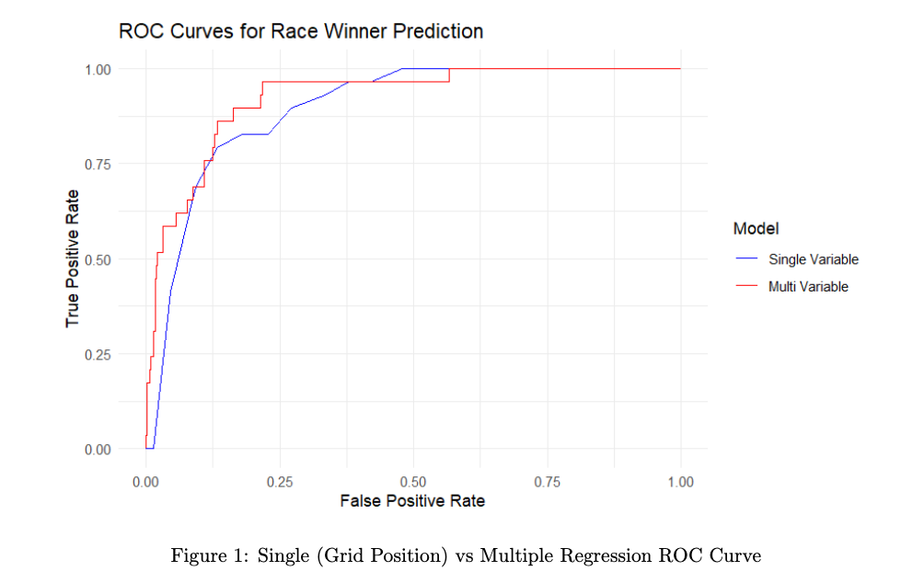
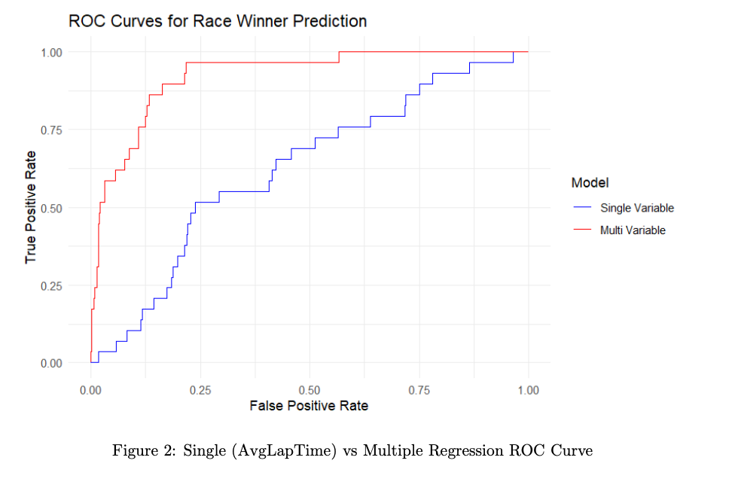
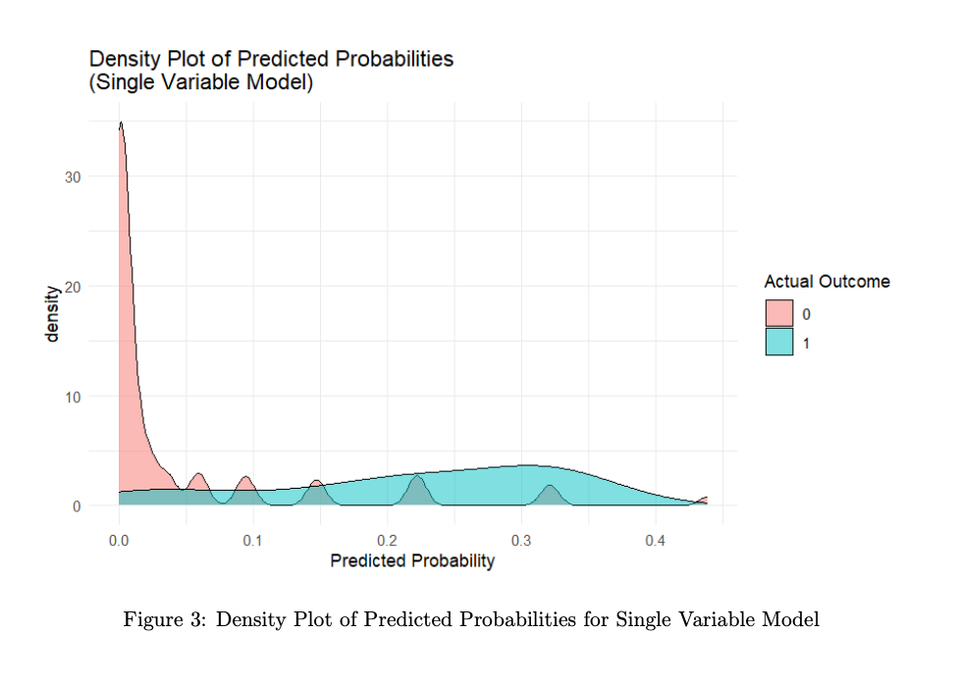
Graphs from logistic regression

Slide 8
Research Question 2: Driver Archetypes (PCA & Clustering)
Method: PCA on standardized metrics (grid, finish, total points, avg lap time).K-means clustering (k=3) to group drivers.
Findings: Three performance tiers emerged (Top, Midfield, Developing).Some drivers switched clusters across seasons (indicates development).

Slide 9
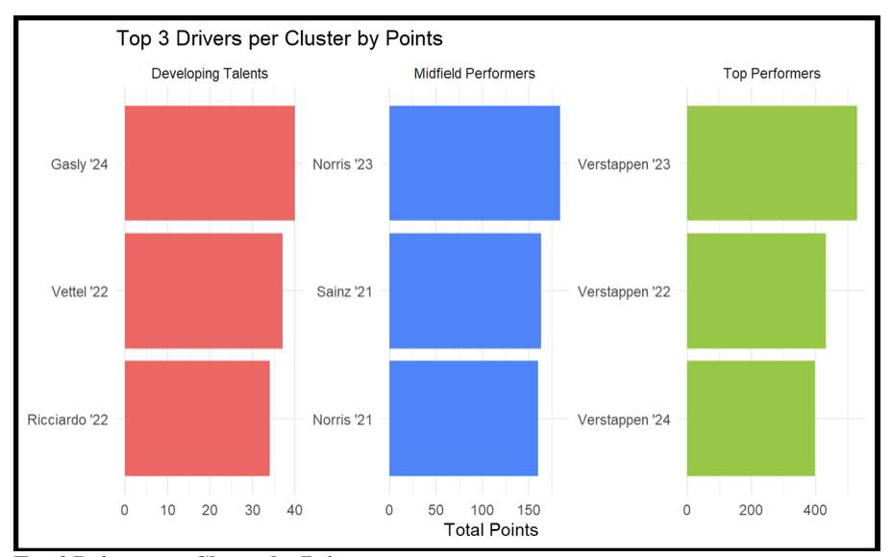
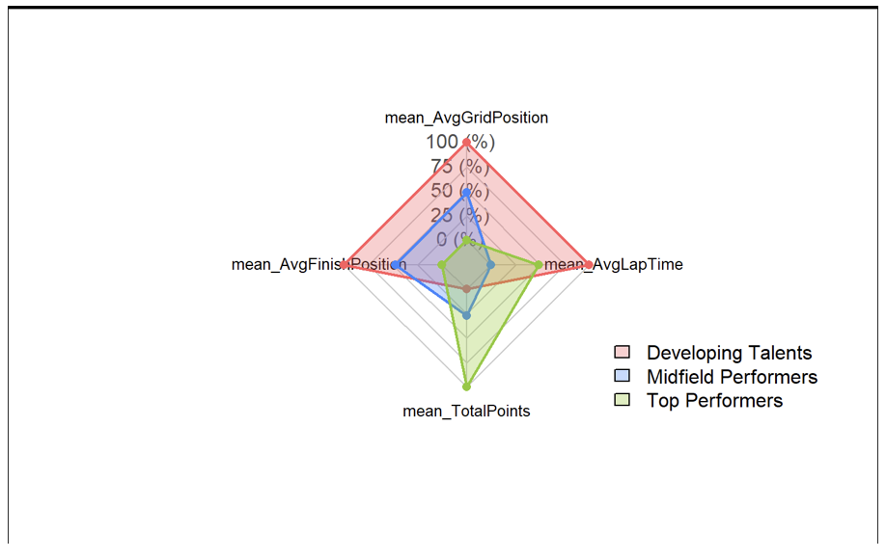
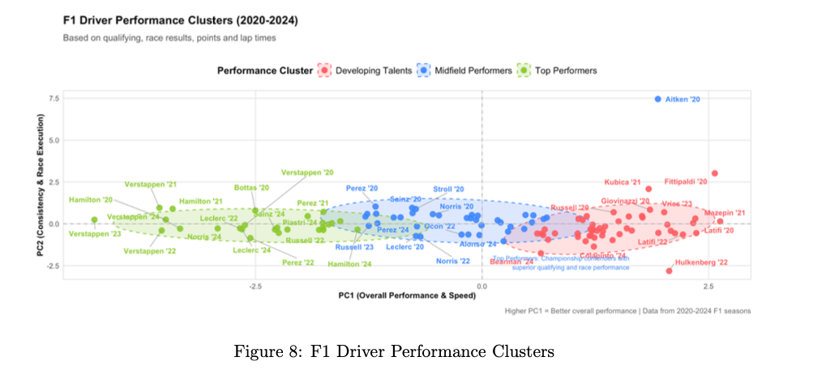
Graphs from PCA & Clustering

Slide 10
Research Question 3: Time-Series & Lap Forecasting
Focus:
Modeled lap times for a specific driver (e.g., Verstappen) using XGBoost regression.
Outcome:
Model R² ~ 0.825; strong predictive power for lap-by-lap performance.
Pit-stop timing insights: staying out vs. pitting based on predicted degradation trends.

Slide 11
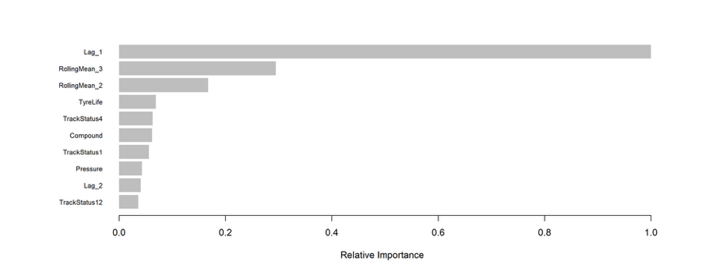
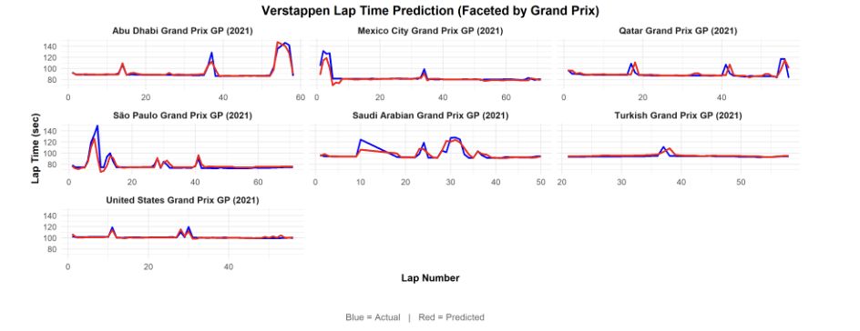
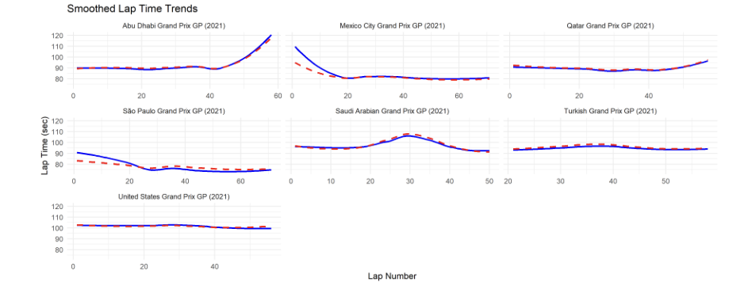
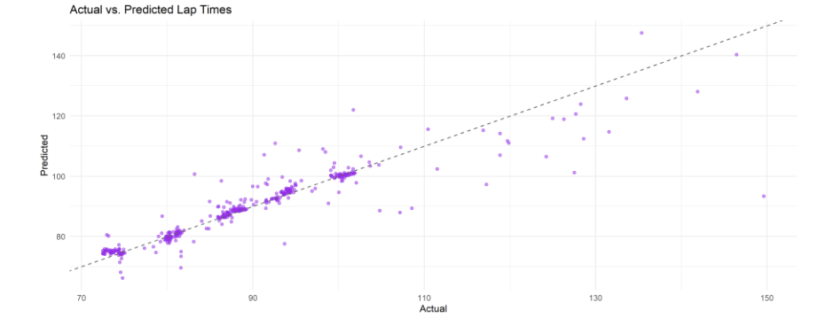
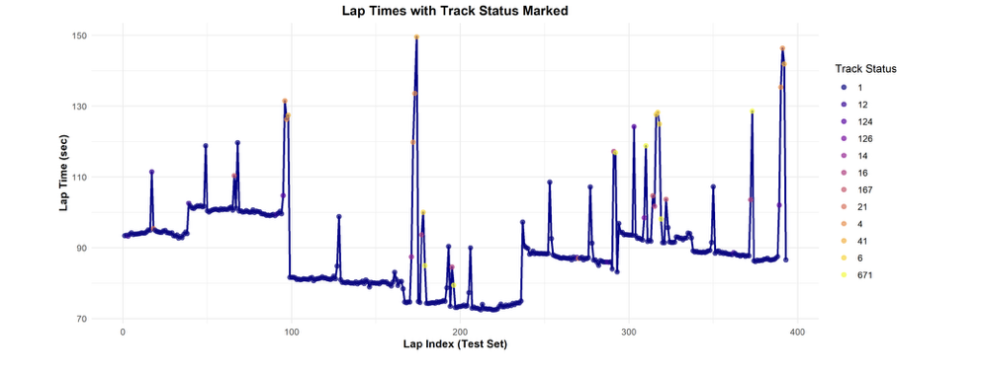
Graphs from Time-Series & Lap Forecasting

Slide 12
Key Results & Discussion
01
Logistic Regression
Grid position is crucial but integrated features improve predictions
02
PCA/Clustering
Clear performance groupings; highlights top contenders and developing drivers.
03
Time-Series Modelling
Informs real-time decisions (pit strategy) with strong accuracy.

Slide 13
Conclusion
Summary: Advanced analytics (regression, clustering, time-series) uncover pivotal insights in F1.
Practical Impact: Better qualifying strategies, driver development focus, and pit-stop decisions.

Slide 14
Thank You
Statistical Computing
Team Members
Ishaan Potle
Aditya Kamat
Janhavi Tingre
Yashwant Reddu Bhuma
Lokesh Mandarapu

